Slide 2
GRADUATION THESIS

Slide 3

SPARTA-GEMSTONE: A two-phase approach for
efficient node placement in 3D wireless sensor
networks under Q-Coverage and Q-Connectivity
constraints
Truong Vu
Supervisor: Trinh Van Chien

Slide 4
Table of contents
1. Introduction
2. Related work
3. Problem formulation
4. Proposed method
5. Experimental result
6. Conclusion

Slide 5
Table of contents
1. Introduction
2. Related work
3. Problem formulation
4. Proposed method
5. Experimental result
6. Conclusion

Slide 6
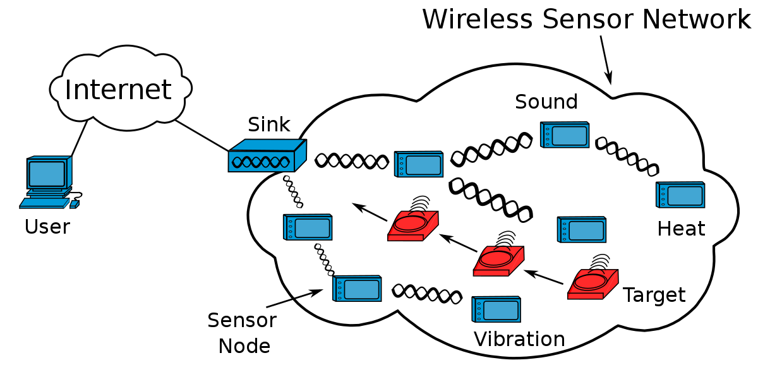
1. Introduction
Wireless sensor networks (WSNs):

Slide 7







1. Introduction
Applications:
Smart home
Medical
Argriculture
Applications
Military
Transport
Industry

Slide 8

1. Introduction
Multi-coverage and multi-connection WSNs:
Base station
Targets
Sensor nodes
Relay nodes

Slide 9
Table of contents
1. Introduction
2. Related work
3. Problem formulation
4. Proposed method
5. Experimental result
6. Conclusion

Slide 10
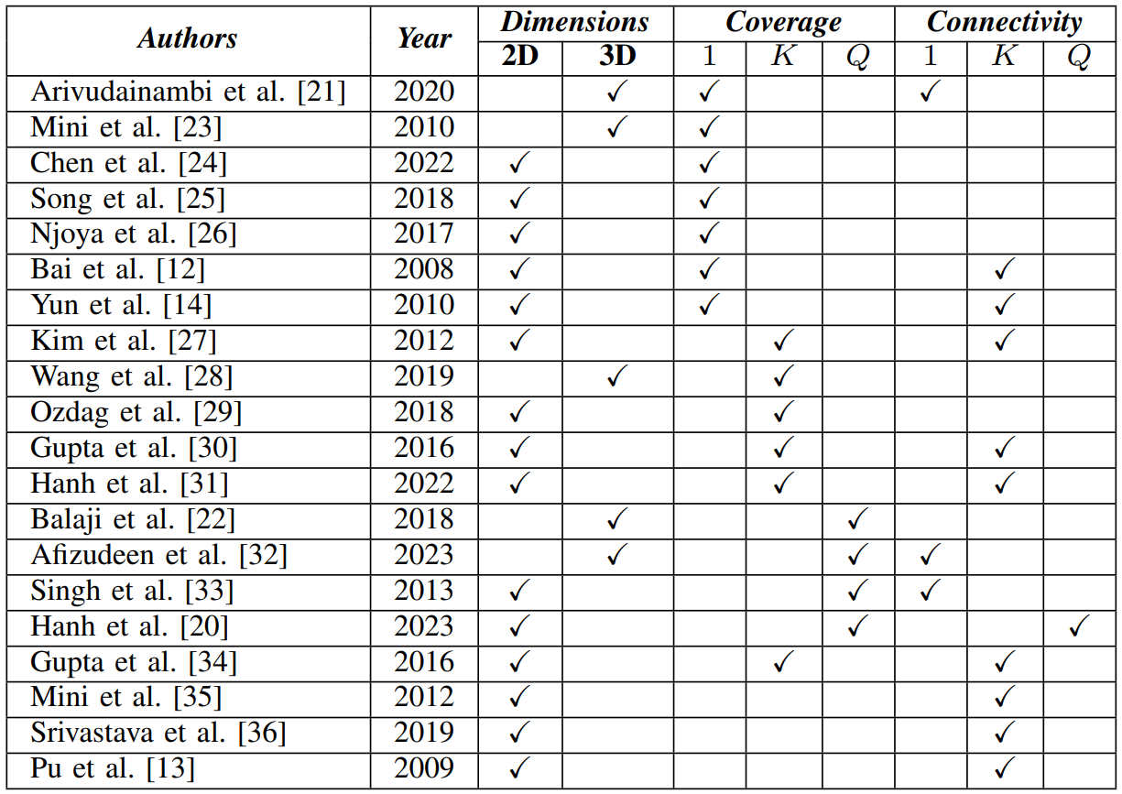
Related work

Slide 11
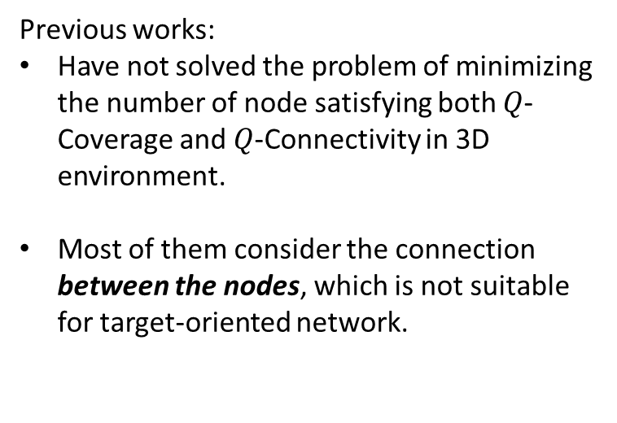
Related work
Previous works:
Have not solved the problem of minimizing the number of node satisfying both $Q$-Coverage and $Q$-Connectivity in 3D environment.
Most of them consider the connection between the nodes, which is not suitable for target-oriented network.

Slide 12
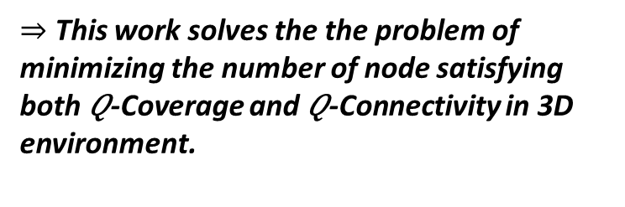
Related work
Previous works:
Have not solved the problem of minimizing the number of node satisfying both $Q$-Coverage and $Q$-Connectivity in 3D environment.
Most of them consider the connection between the nodes, which is not suitable for target-oriented network.
$⇒$ This work solves the the problem of minimizing the number of node satisfying both 𝑄-Coverage and 𝑄-Connectivity in 3D environment.
Connections between nodes
Connections from target to base station

Slide 13
Table of contents
1. Introduction
2. Related work
3. Problem formulation
4. Proposed method
5. Experimental result
6. Conclusion

Slide 14
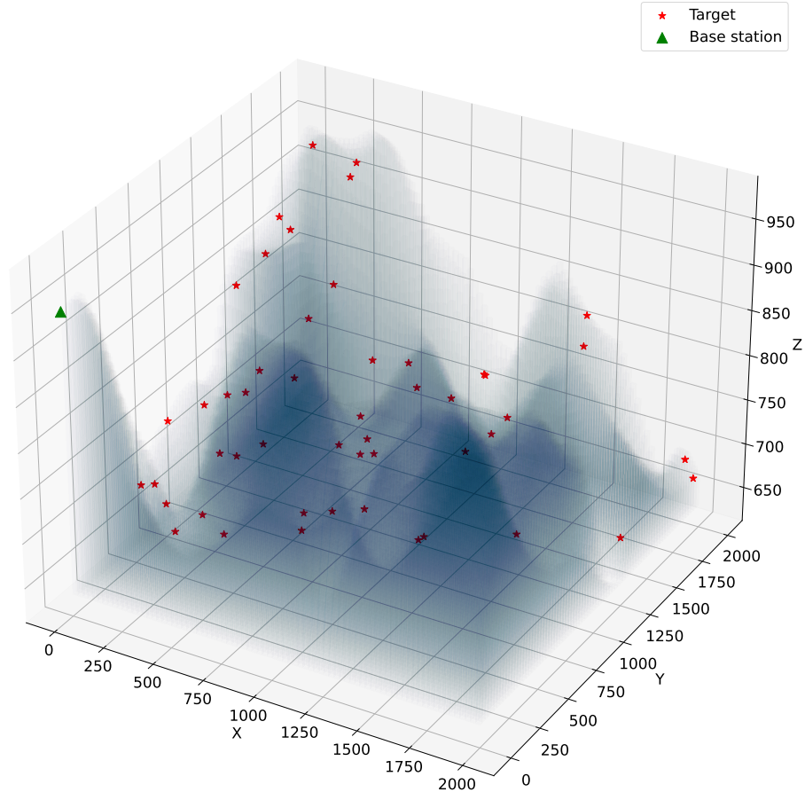
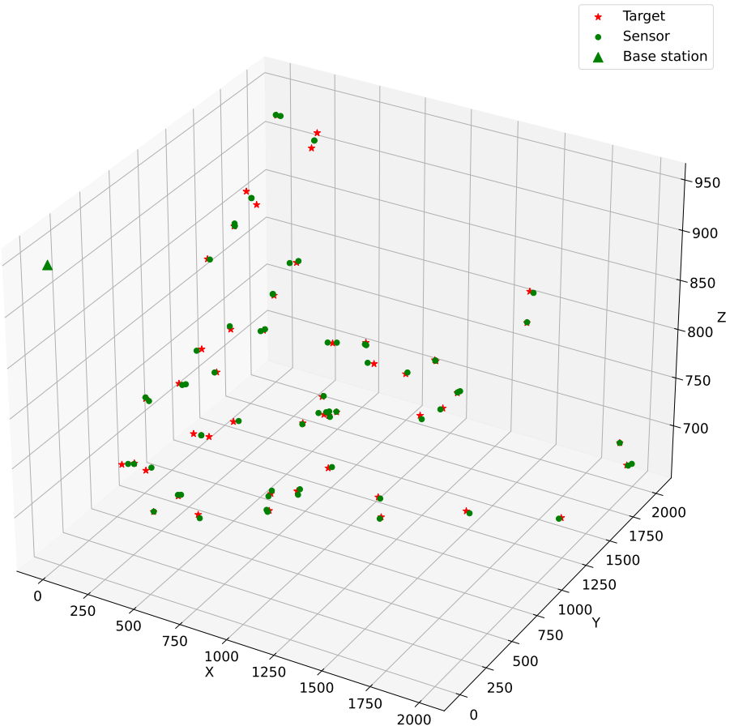
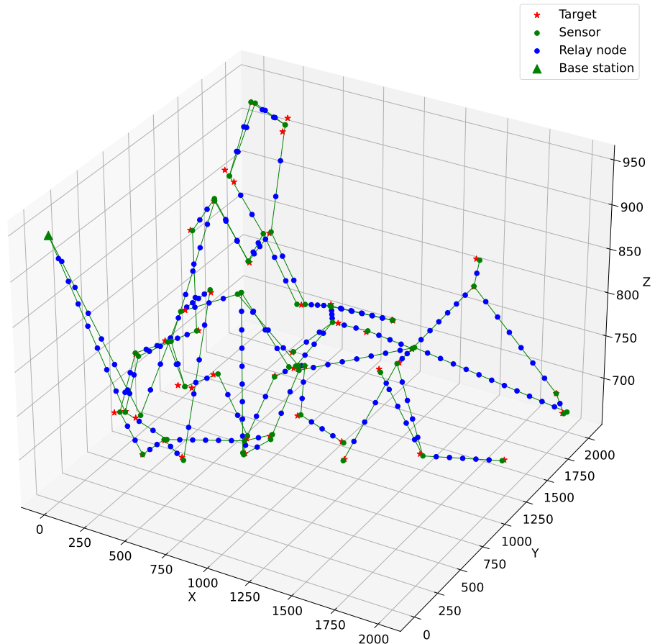
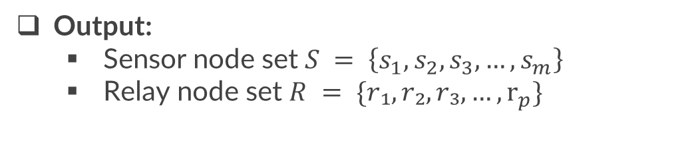
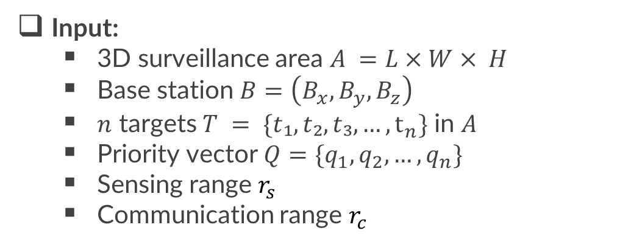
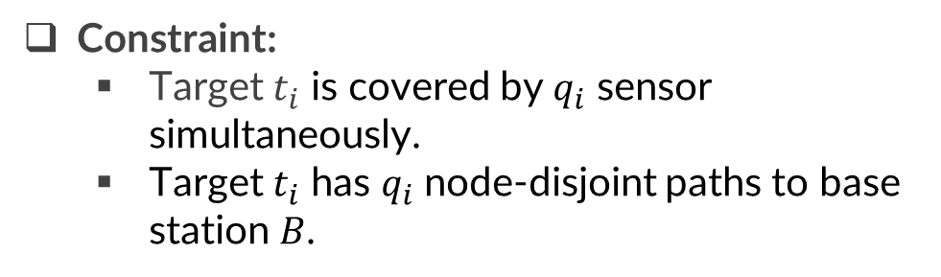
3. Problem formulation
Input:
3D surveillance area $A =L×W× H$
Base station $B=\left(B_{x}, B_{y},B_{z}\right)$
$n$ targets $T = \{t₁, t₂, t₃, …, t_{n}\}$ in $A$
Priority vector $Q=\{q_{1},q_{2},…,q_{n}\}$
Sensing range $r_{s}$
Communication range $r_{c}$
Constraint:
Target $t_{i}$ is covered by $q_{i}$ sensor simultaneously.
Target $t_{i}$ has $q_{i}$ node-disjoint paths to base station $B$.
Output:
Sensor node set $S = \left\{s_{1}, s_{2}, s_{3}, …, s_{m}\right\}$
Relay node set $R = \{r₁, r₂, r₃, …, r_{p}\}$
Objective:
Minimizing |𝑅|+|𝑆|

Slide 15
Table of contents
1. Introduction
2. Related work
3. Problem formulation
4. Proposed method
5. Experimental result
6. Conclusion

Slide 16
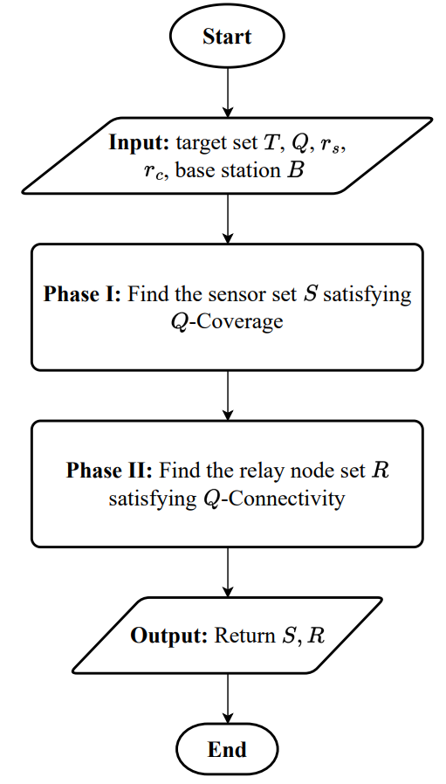
4. Proposed method
Two-phase approach:
SPARTA: Sphere Point And Removal Target Algorithm
GEMSTONE: Graph-based Efficient Minimum Spanning Tree Optimization for Network Establishment

Slide 17

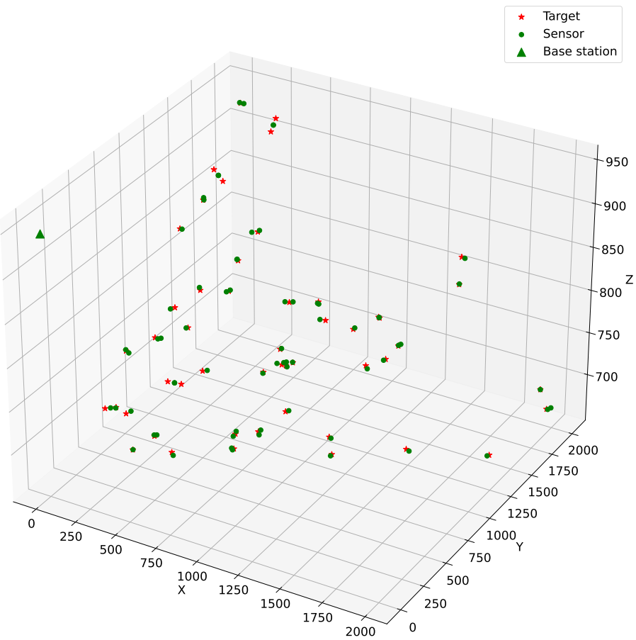
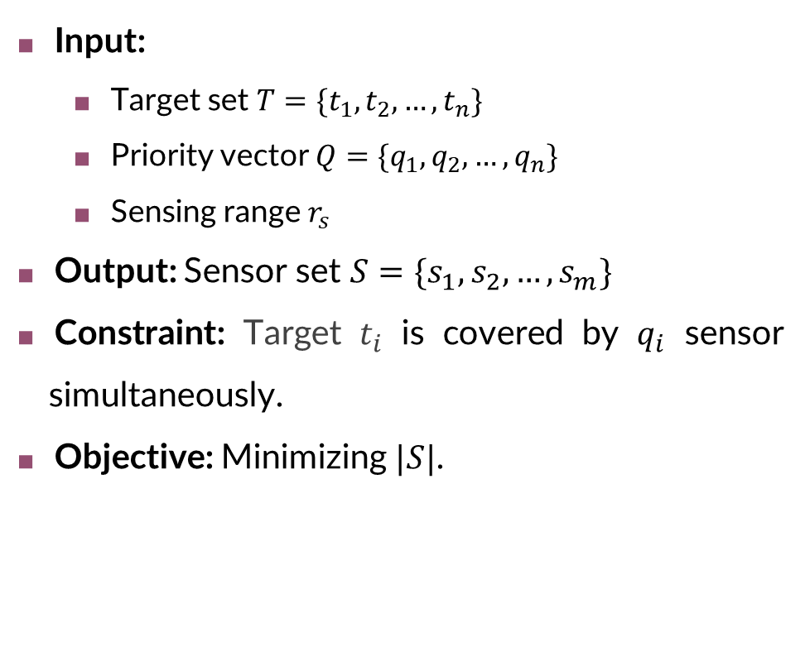
4.1. Phase I: $Q$-Coverage
Input:
Target set $T=\{t_{1},t_{2},…,t_{n}\}$
Priority vector $Q=\{q_{1},q_{2},…,q_{n}\}$
Sensing range $r_{s}$
Output: Sensor set $S=\{s_{1},s_{2},…,s_{m}\}$
Constraint: Target $t_{i}$ is covered by $q_{i}$ sensor simultaneously.
Objective: Minimizing $|S|$.

Slide 18
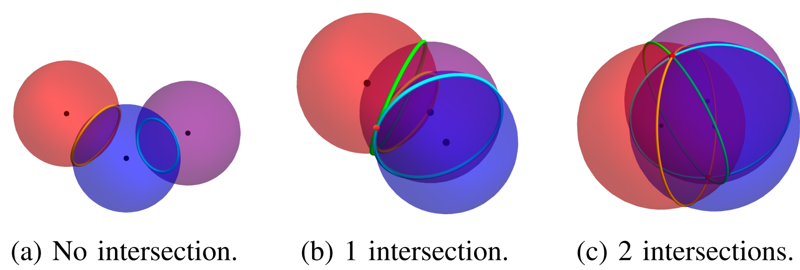
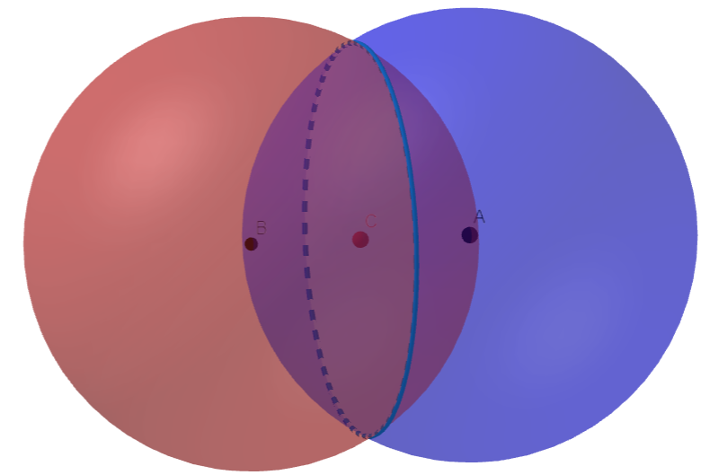
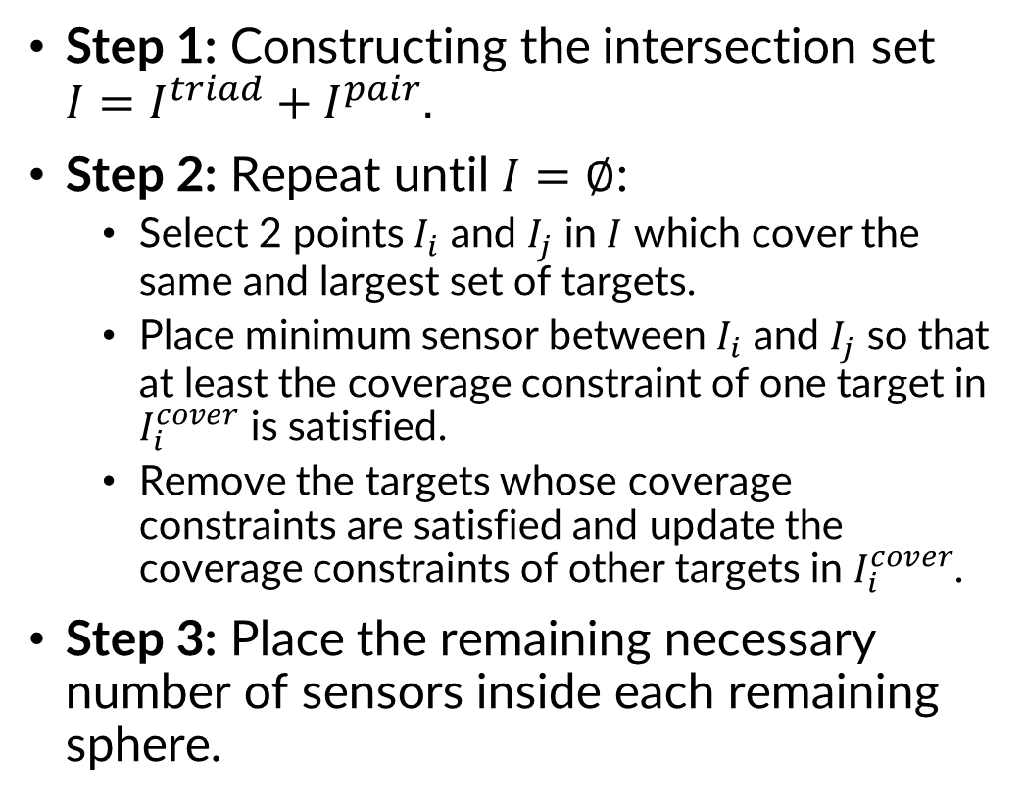
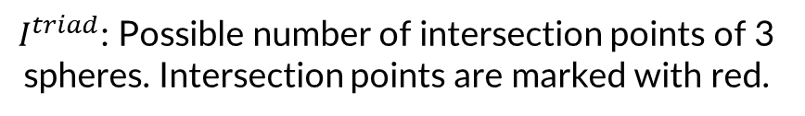
4.1. Phase I: $Q$-Coverage - SPARTA
Step 1: Constructing the intersection set $I=I_{ }^{triad}+I^{pair}.$
Step 2: Repeat until $I=∅$:
Select 2 points $I_{i}$ and $I_{j}$ in $I$ which cover the same and largest set of targets.
Place minimum sensor between $I_{i}$ and $I_{j}$ so that at least the coverage constraint of one target in $I_{i}^{cover}$ is satisfied.
Remove the targets whose coverage constraints are satisfied and update the coverage constraints of other targets in $I_{i}^{cover}$.
Step 3: Place the remaining necessary number of sensors inside each remaining sphere.
$I^{triad}$: Possible number of intersection points of 3 spheres. Intersection points are marked with red.
$I^{pair}$: Mid points of 2 spheres (marked with red).

Slide 19
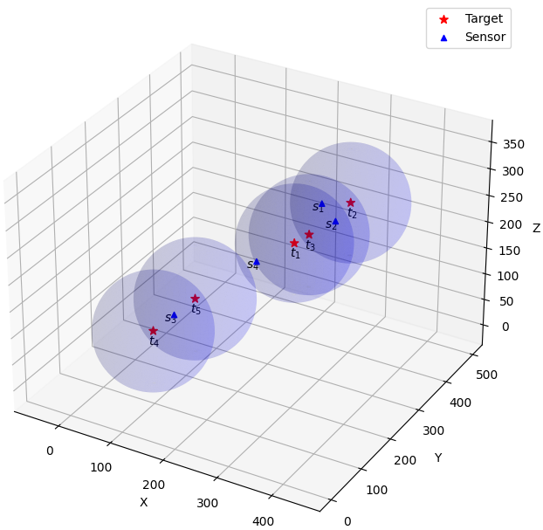
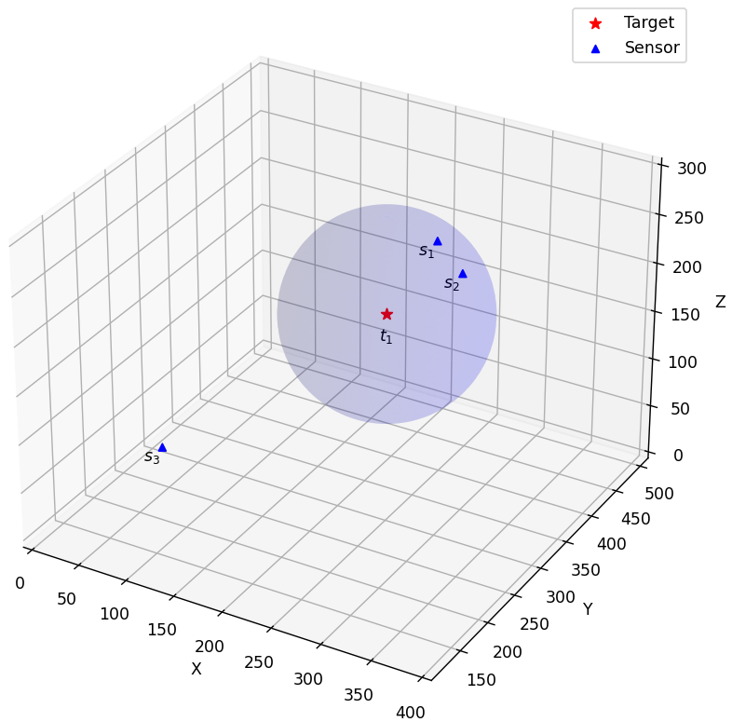
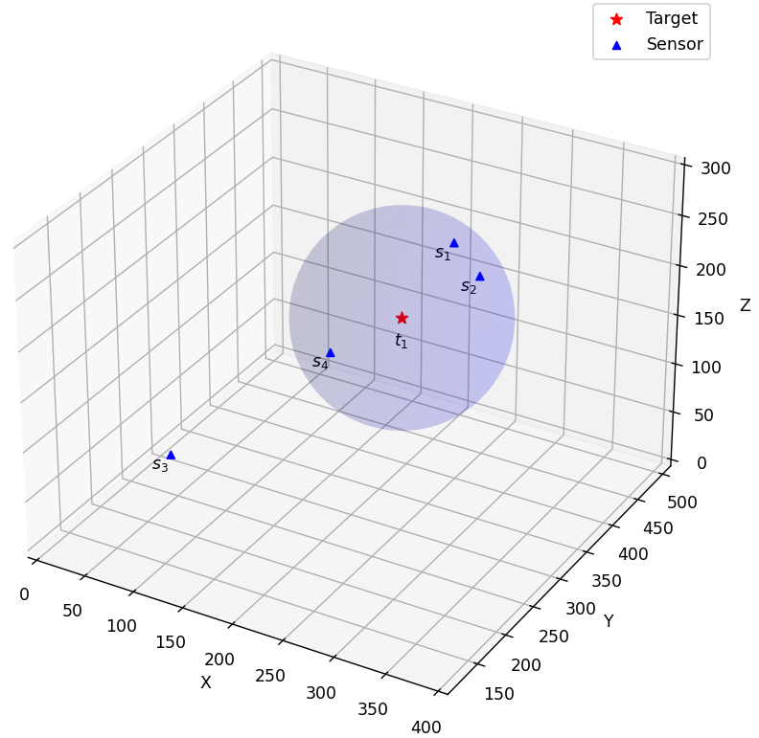
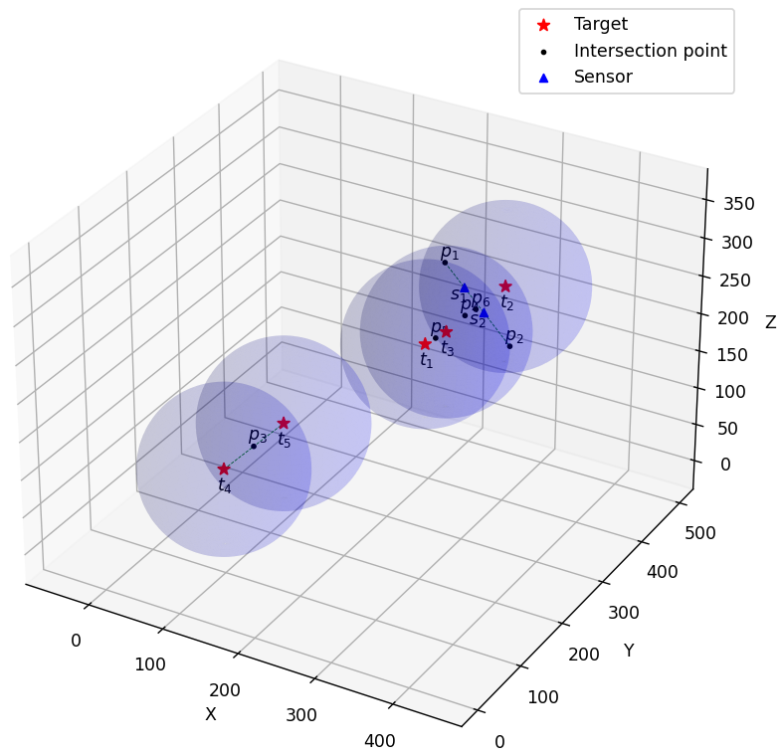
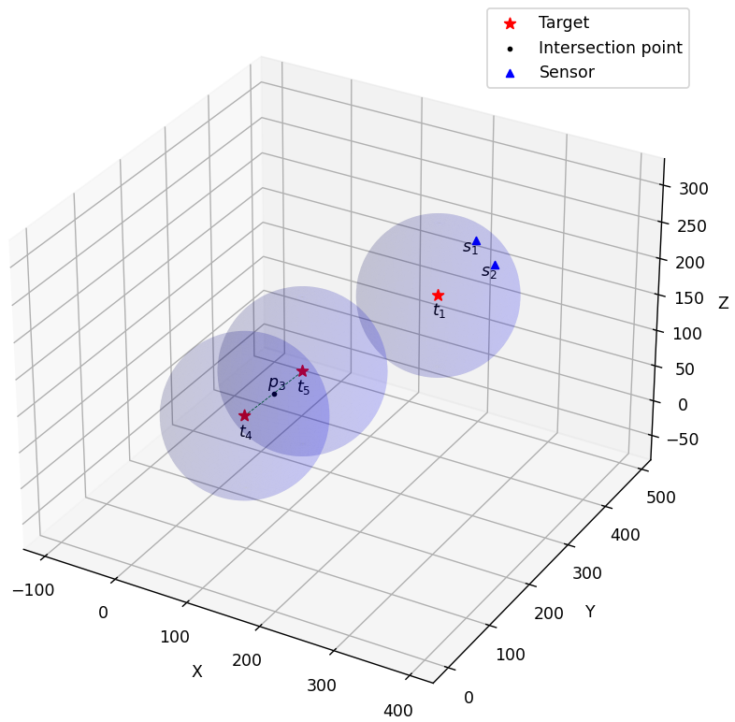
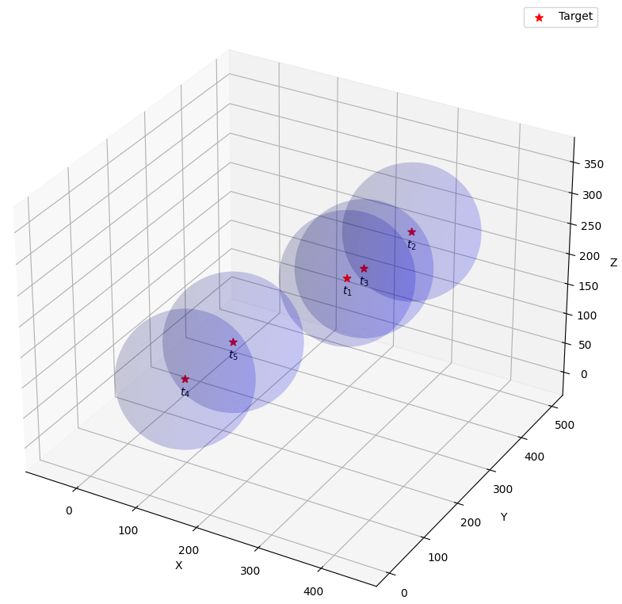
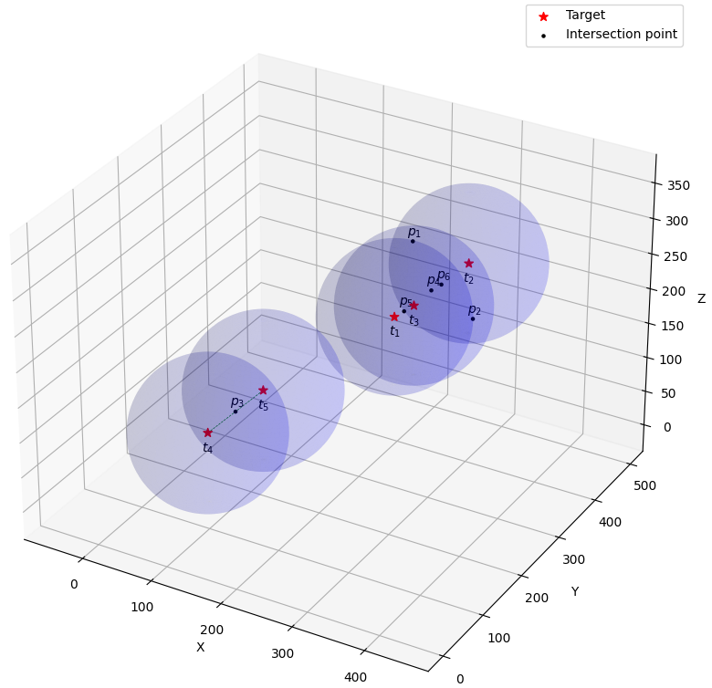
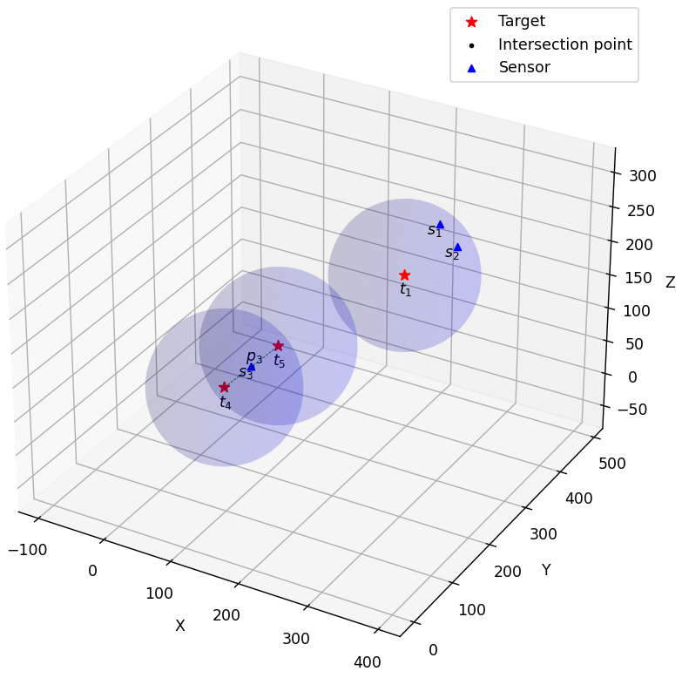
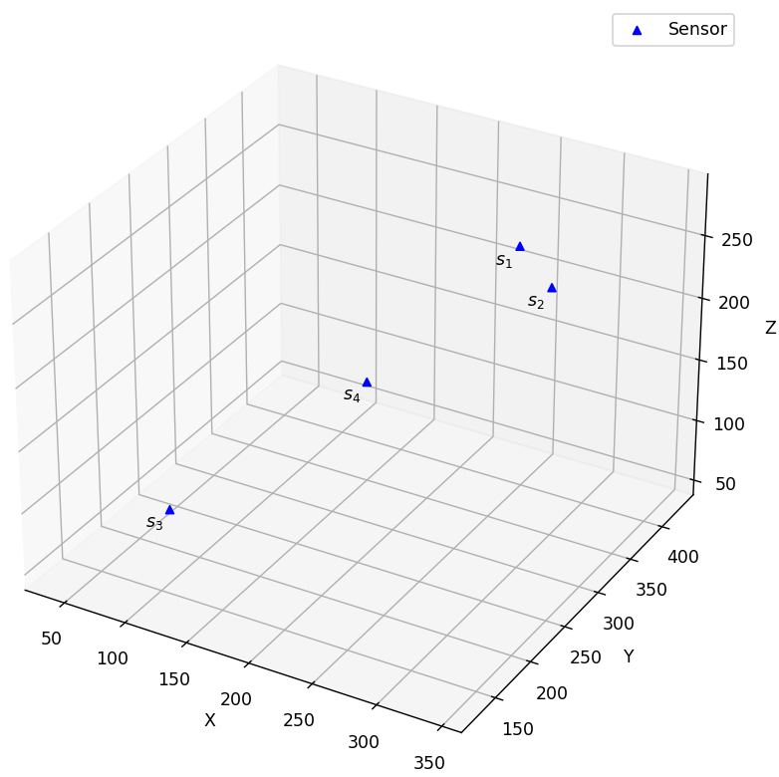
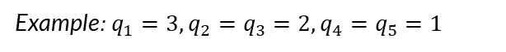
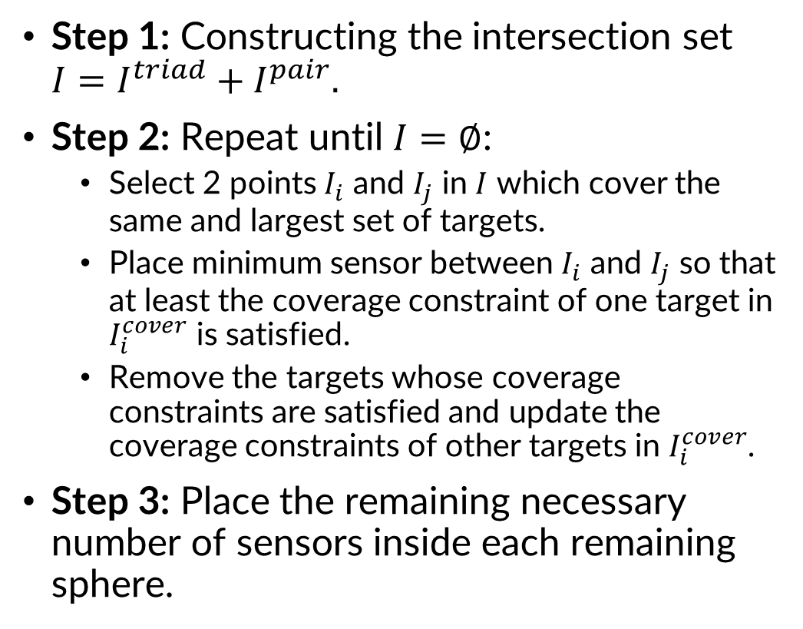
4.1. Phase I: $Q$-Coverage - SPARTA
Example: $q_{1}=3, q_{2}=q_{3}=2, q_{4}=q_{5}=1$
Step 1: Constructing the intersection set $I=I_{ }^{triad}+I^{pair}.$
Step 2: Repeat until $I=∅$:
Select 2 points $I_{i}$ and $I_{j}$ in $I$ which cover the same and largest set of targets.
Place minimum sensor between $I_{i}$ and $I_{j}$ so that at least the coverage constraint of one target in $I_{i}^{cover}$ is satisfied.
Remove the targets whose coverage constraints are satisfied and update the coverage constraints of other targets in $I_{i}^{cover}$.
Step 3: Place the remaining necessary number of sensors inside each remaining sphere.

Slide 20
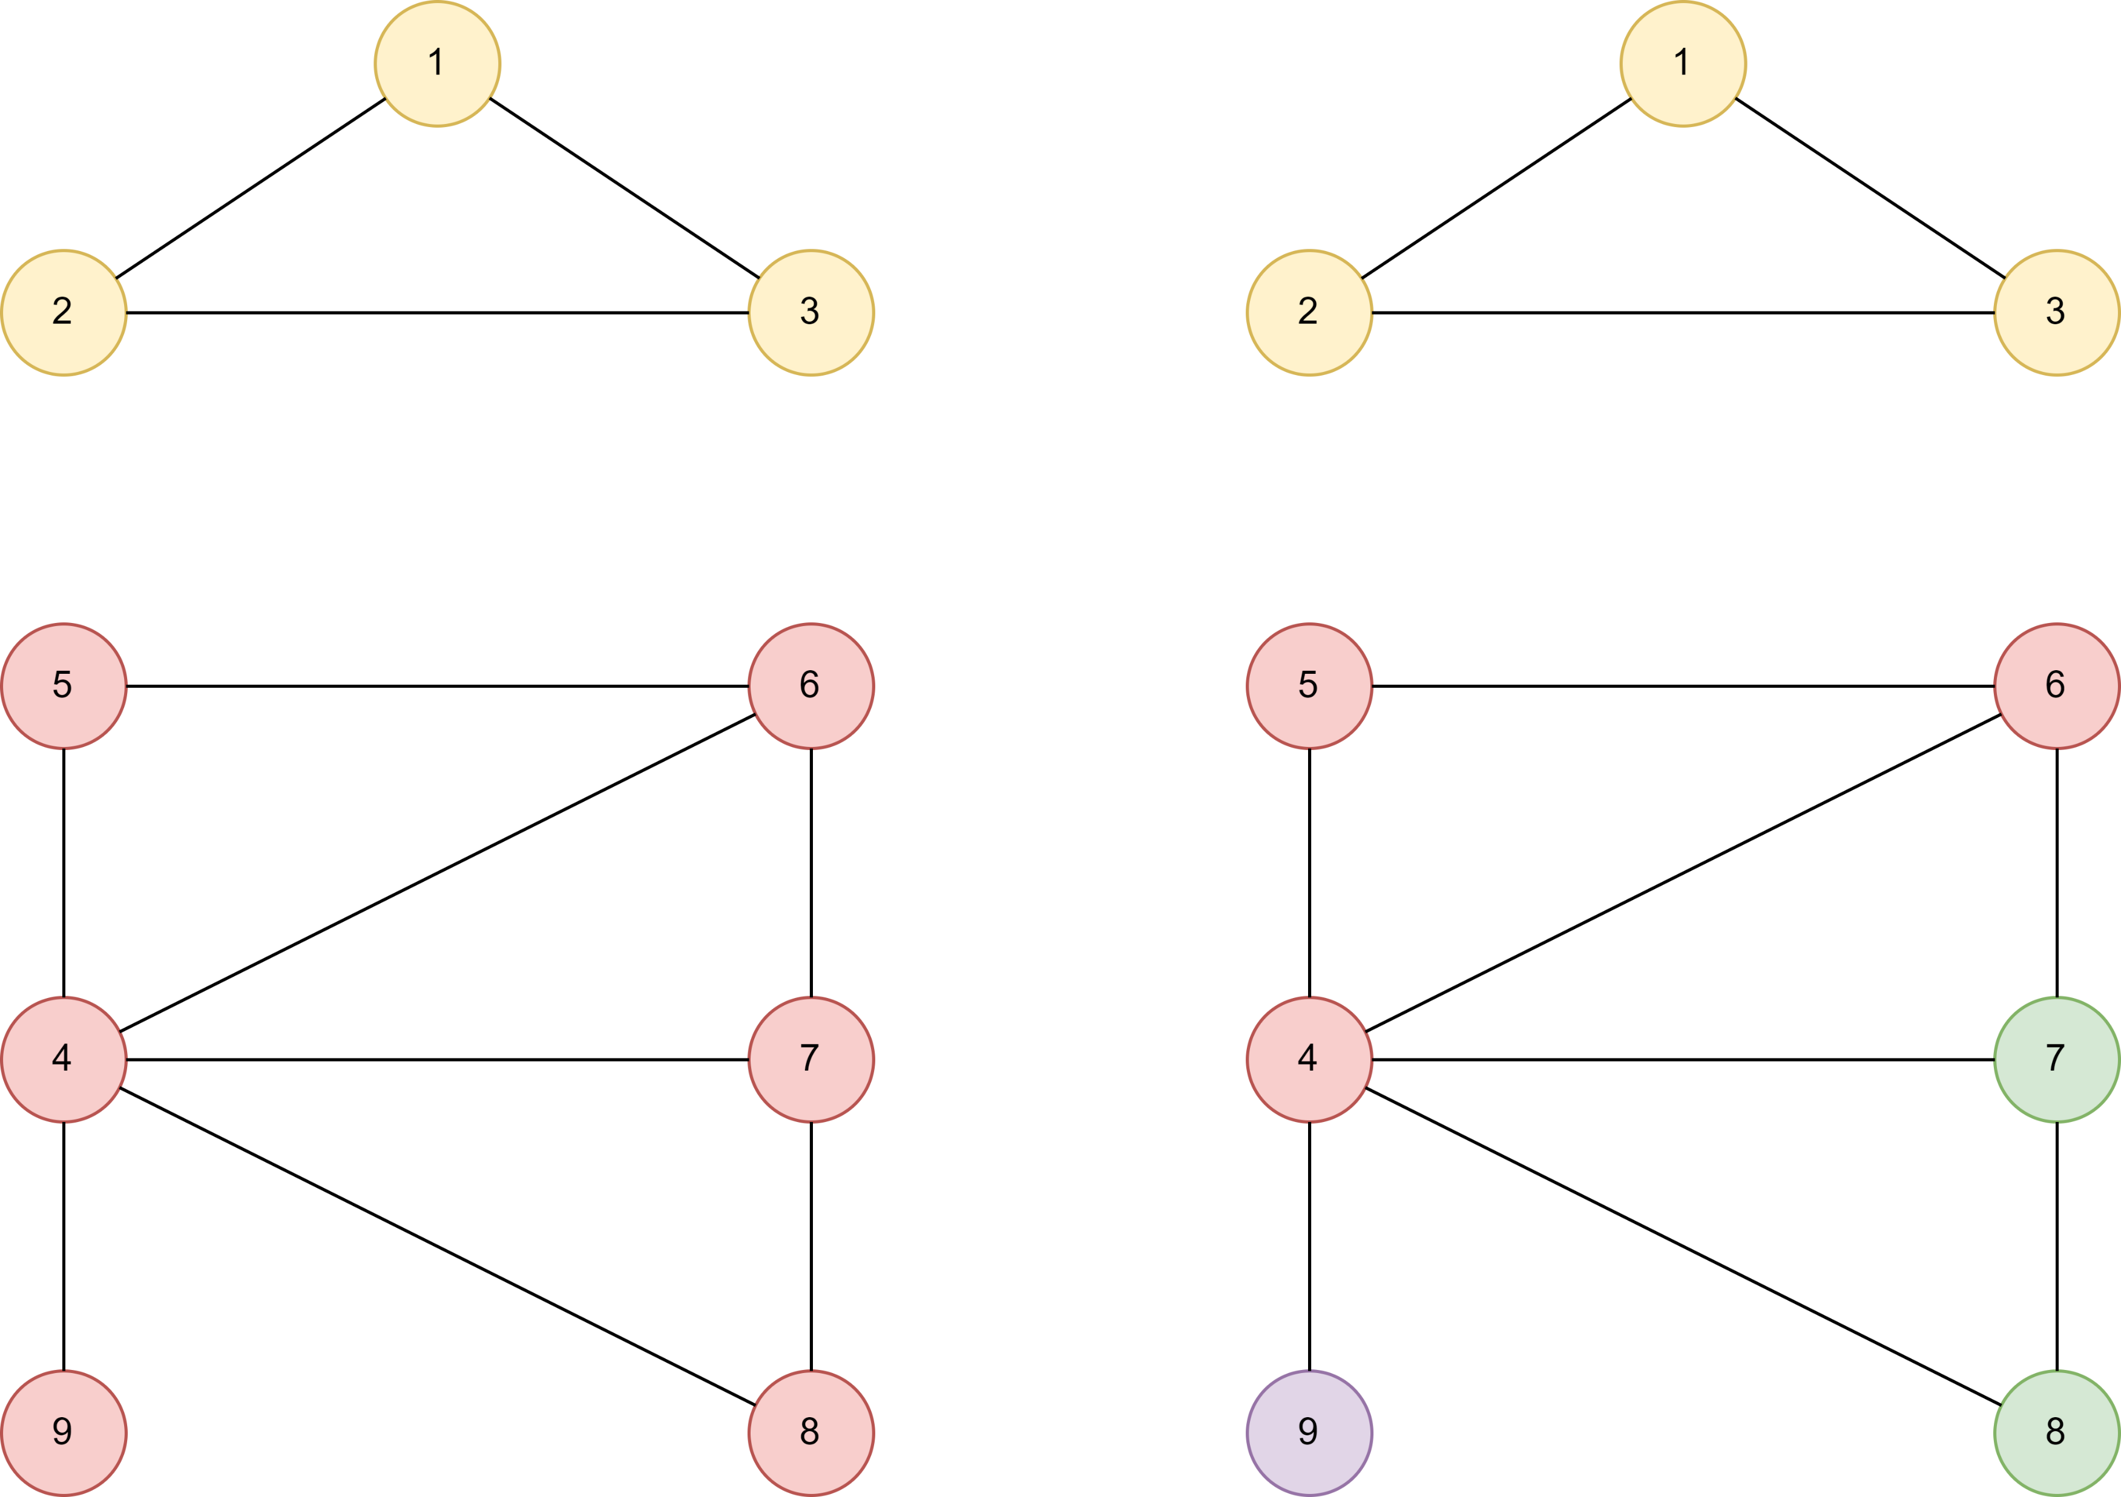
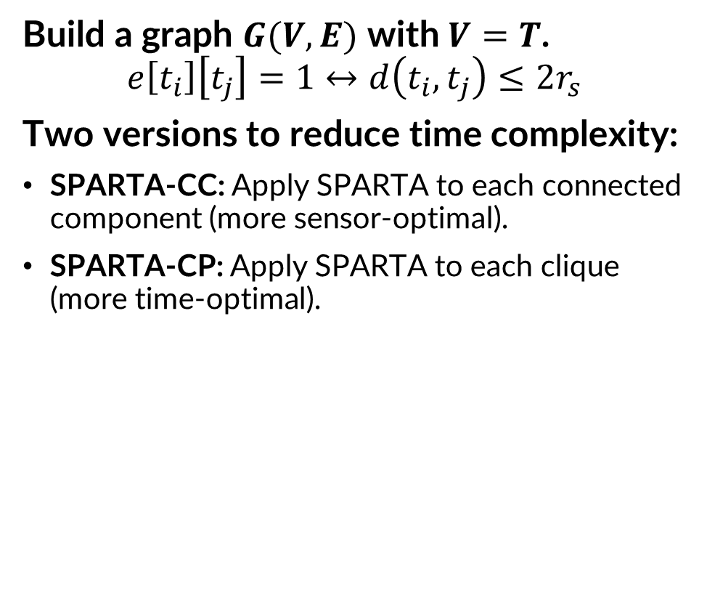
4.1. Phase I: $Q$-Coverage - SPARTA
Build a graph $G(V,E)$ with $V=T$.
$$e\left[t_{i}\right]\left[t_{j}\right]=1↔d\left(t_{i},t_{j}\right)≤2r_{s}$$
Two versions to reduce time complexity:
SPARTA-CC: Apply SPARTA to each connected component (more sensor-optimal).
SPARTA-CP: Apply SPARTA to each clique (more time-optimal).
a) Connected components
b) Clique-partitioning

Slide 21
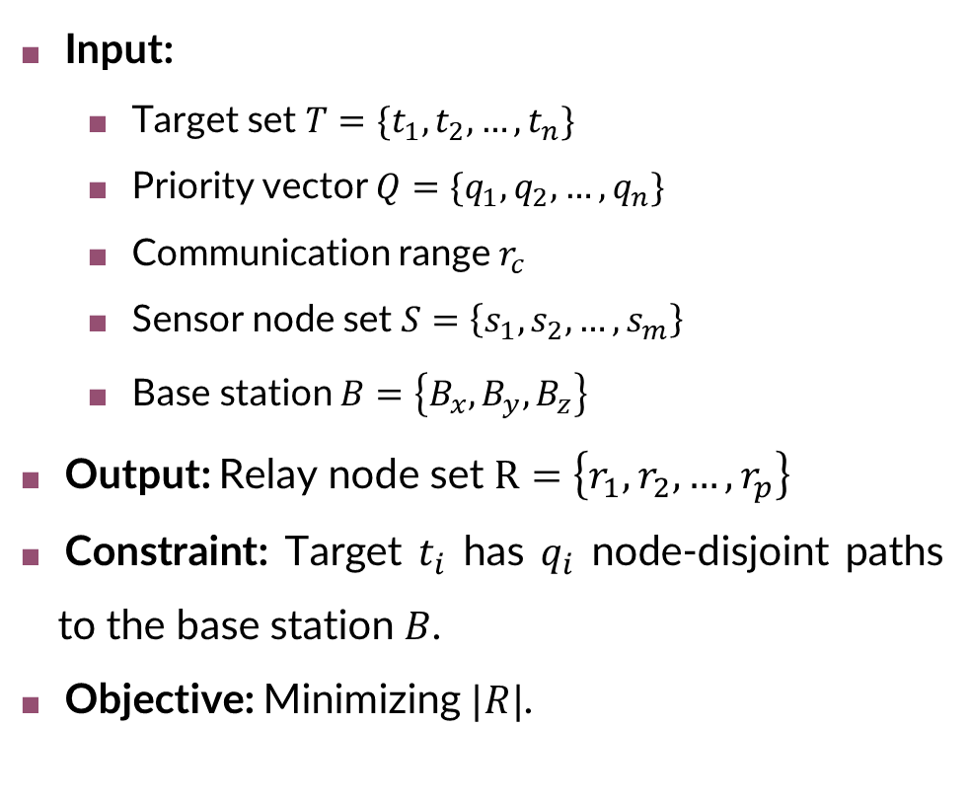
4.2. Phase II: $Q$-Connectivity
Input:
Target set $T=\{t_{1},t_{2},…,t_{n}\}$
Priority vector $Q=\{q_{1},q_{2},…,q_{n}\}$
Communication range $r_{c}$
Sensor node set $S=\left\{s_{1},s_{2},…,s_{m}\right\}$
Base station $B=\left\{B_{x},B_{y}, B_{z}\right\}$
Output: Relay node set $R=\left\{r_{1},r_{2},…, r_{p}\right\}$
Constraint: Target $t_{i}$ has $q_{i}$ node-disjoint paths to the base station $B$.
Objective: Minimizing $|R|$.

Slide 22
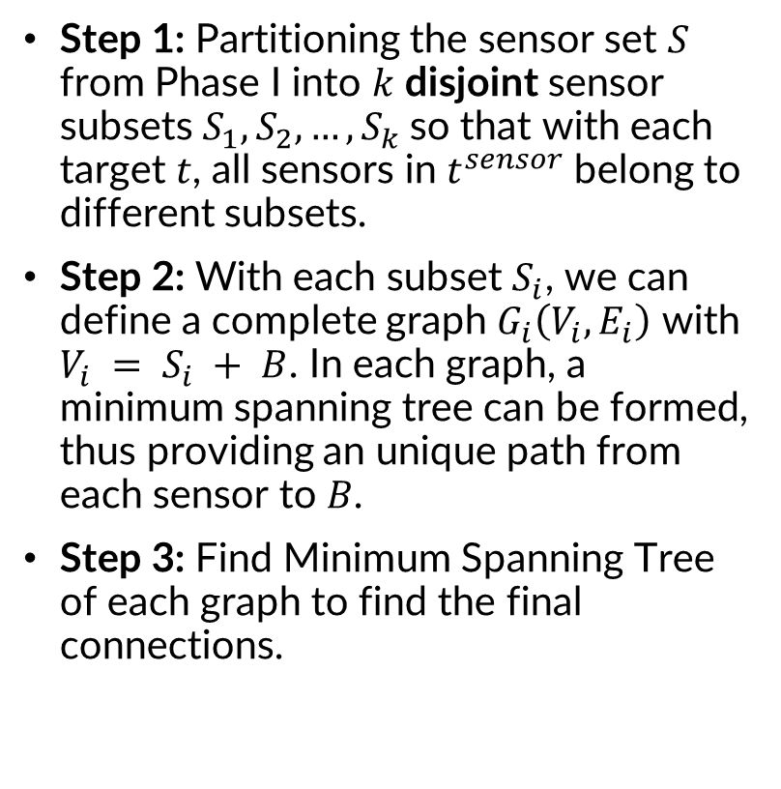
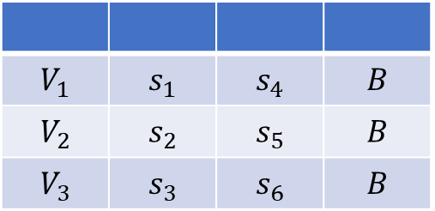
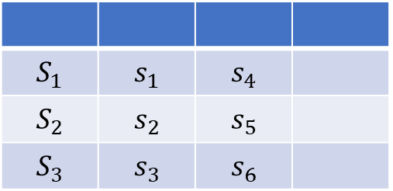
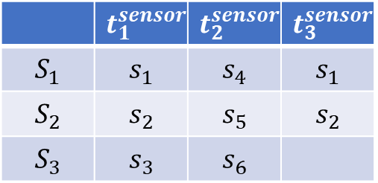
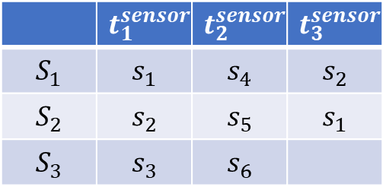
4.2. Phase II: $Q$-Connectivity - GEMSTONE
Step 1: Partitioning the sensor set $S$ from Phase I into $k$ disjoint sensor subsets $S_{1},S_{2},…,S_{k}$so that with each target $t$, all sensors in $t^{sensor}$ belong to different subsets.
Step 2: With each subset $S_{i}$, we can define a complete graph $G_{i}\left(V_{i},E_{i}\right)$ with $V_{i} = S_{i} + B$. In each graph, a minimum spanning tree can be formed, thus providing an unique path from each sensor to $B$.
Step 3: Find Minimum Spanning Tree of each graph to find the final connections.
 | $$t_{1}^{sensor}$$ | $$t_{2}^{sensor}$$ | $$t_{3}^{sensor}$$
$$S_{1}$$ | $$s_{1}$$ | $$s_{4}$$ | $$s_{2}$$
$$S_{2}$$ | $$s_{2}$$ | $$s_{5}$$ | $$s_{1}$$
$$S_{3}$$ | $$s_{3}$$ | $$s_{6}$$
 | $$t_{1}^{sensor}$$ | $$t_{2}^{sensor}$$ | $$t_{3}^{sensor}$$
$$S_{1}$$ | $$s_{1}$$ | $$s_{4}$$ | $$s_{1}$$
$$S_{2}$$ | $$s_{2}$$ | $$s_{5}$$ | $$s_{2}$$
$$S_{3}$$ | $$s_{3}$$ | $$s_{6}$$
$$V_{1}$$ | $$s_{1}$$ | $$s_{4}$$ | $$B$$
$$V_{2}$$ | $$s_{2}$$ | $$s_{5}$$ | $$B$$
$$V_{3}$$ | $$s_{3}$$ | $$s_{6}$$ | $$B$$
$$S_{1}$$ | $$s_{1}$$ | $$s_{4}$$
$$S_{2}$$ | $$s_{2}$$ | $$s_{5}$$
$$S_{3}$$ | $$s_{3}$$ | $$s_{6}$$

Slide 23
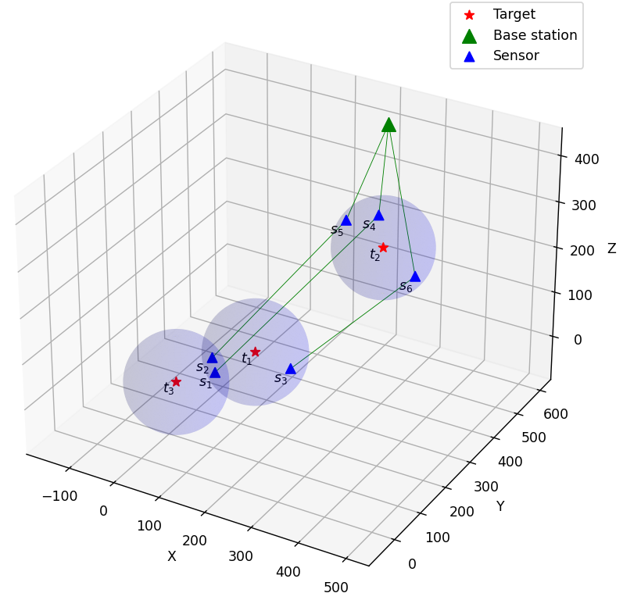
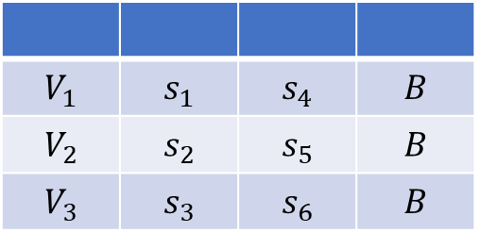
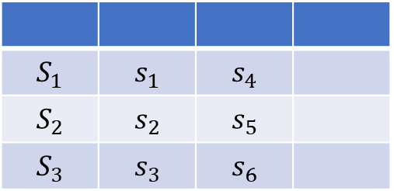
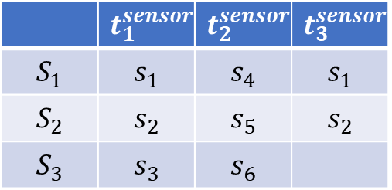
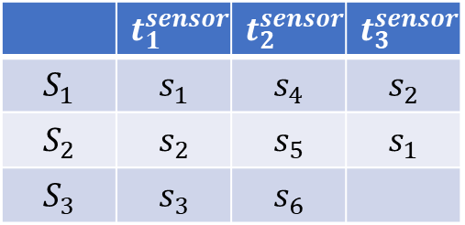
4.2. Phase II: $Q$-Connectivity - GEMSTONE
 | $$t_{1}^{sensor}$$ | $$t_{2}^{sensor}$$ | $$t_{3}^{sensor}$$
$$S_{1}$$ | $$s_{1}$$ | $$s_{4}$$ | $$s_{2}$$
$$S_{2}$$ | $$s_{2}$$ | $$s_{5}$$ | $$s_{1}$$
$$S_{3}$$ | $$s_{3}$$ | $$s_{6}$$
 | $$t_{1}^{sensor}$$ | $$t_{2}^{sensor}$$ | $$t_{3}^{sensor}$$
$$S_{1}$$ | $$s_{1}$$ | $$s_{4}$$ | $$s_{1}$$
$$S_{2}$$ | $$s_{2}$$ | $$s_{5}$$ | $$s_{2}$$
$$S_{3}$$ | $$s_{3}$$ | $$s_{6}$$
$$V_{1}$$ | $$s_{1}$$ | $$s_{4}$$ | $$B$$
$$V_{2}$$ | $$s_{2}$$ | $$s_{5}$$ | $$B$$
$$V_{3}$$ | $$s_{3}$$ | $$s_{6}$$ | $$B$$
$$S_{1}$$ | $$s_{1}$$ | $$s_{4}$$
$$S_{2}$$ | $$s_{2}$$ | $$s_{5}$$
$$S_{3}$$ | $$s_{3}$$ | $$s_{6}$$

Slide 24
Table of contents
1. Introduction
2. Related work
3. Problem formulation
4. Proposed method
5. Experimental result
5.1. Dataset
5.2. Parameter settings
5.1. Experiment scenario
5.2. Experiment result
6. Conclusion

Slide 25
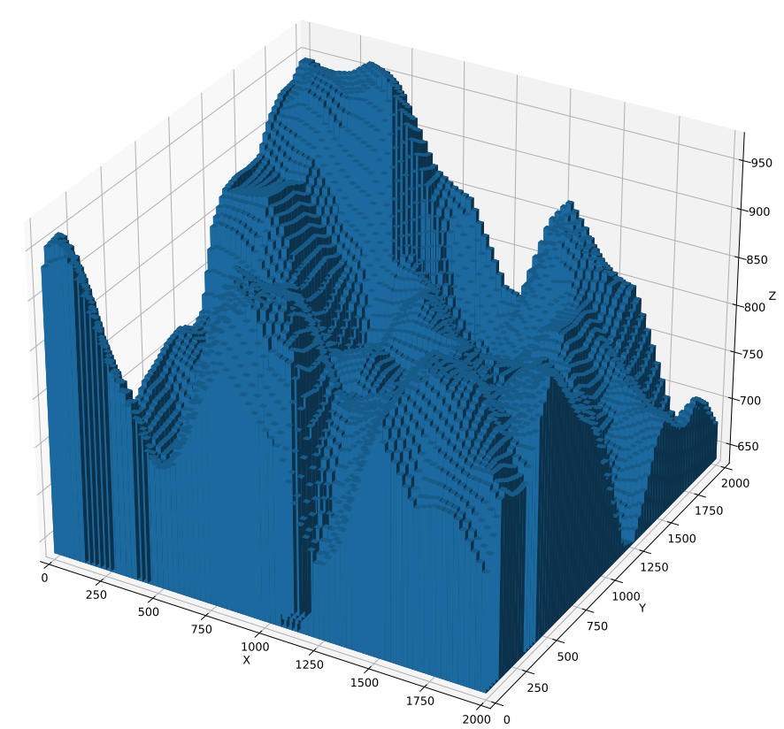
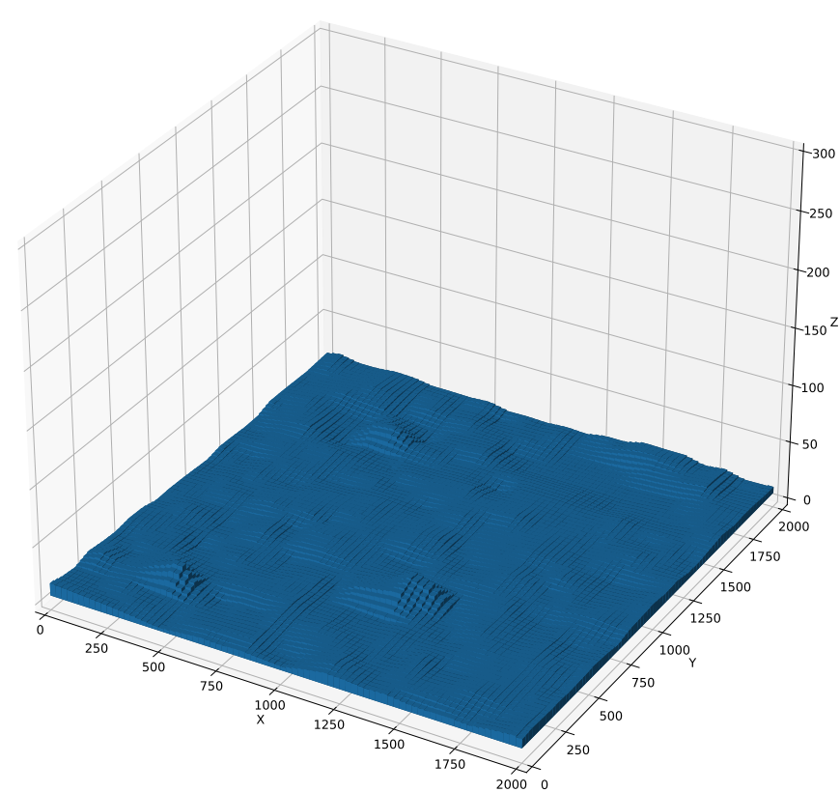
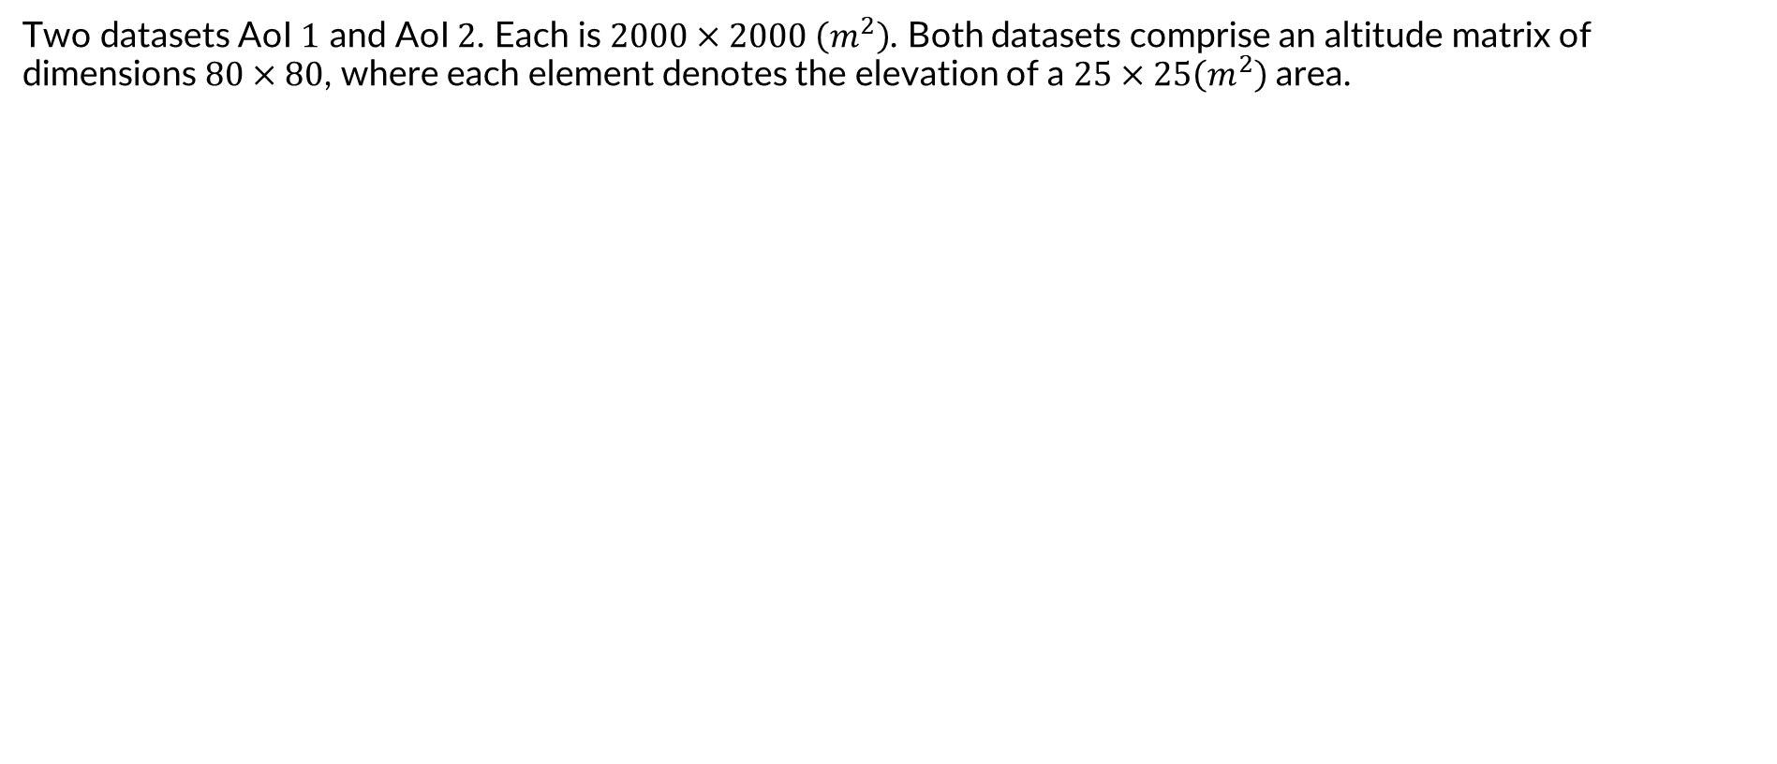
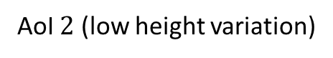
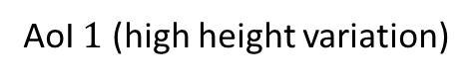
5.1. Dataset
Two datasets AoI $1$ and AoI $2$. Each is $2000×2000 \left(m^{2}\right)$. Both datasets comprise an altitude matrix of dimensions $80×80$, where each element denotes the elevation of a $25×25\left(m^{2}\right)$area.
AoI $1$ (high height variation)
AoI $2$ (low height variation)

Slide 26
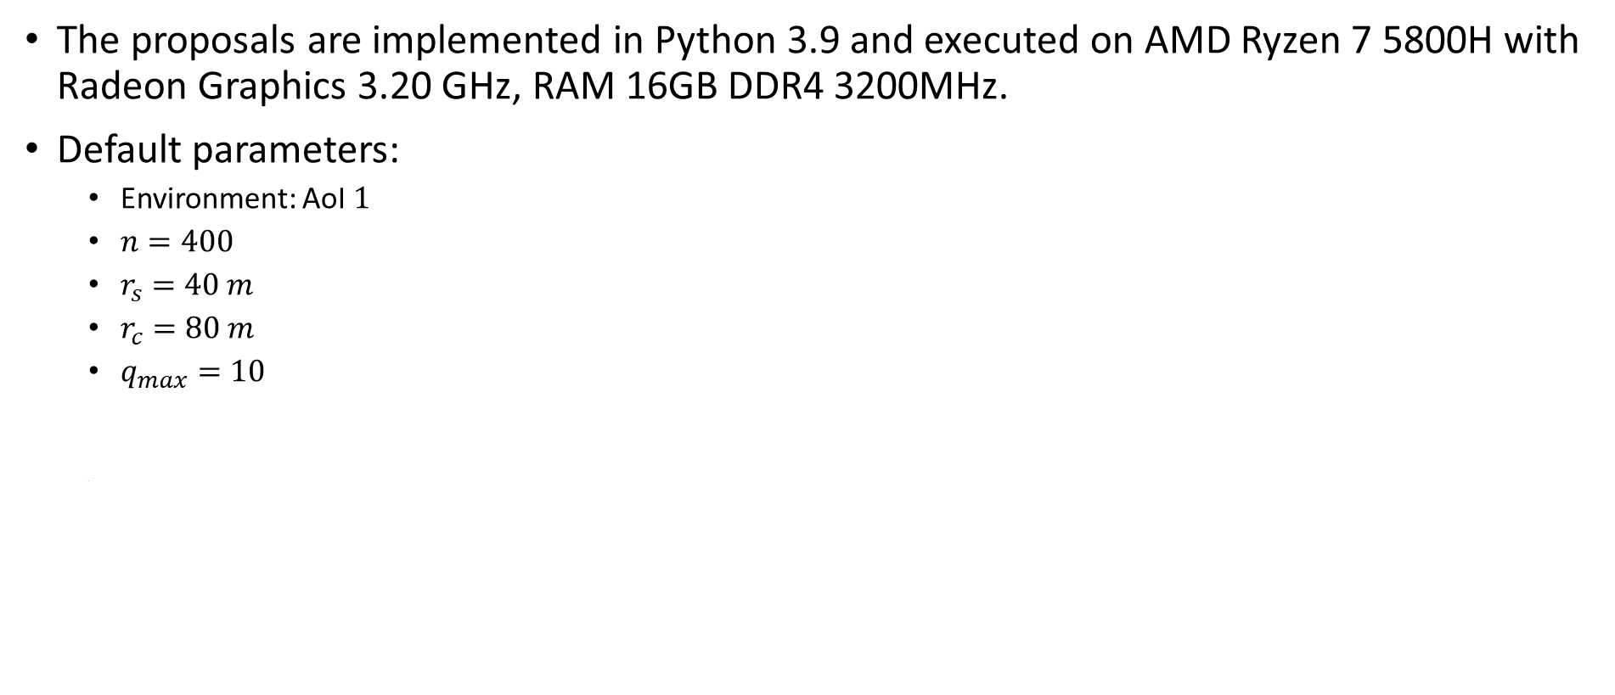
5.2. Parameter settings
The proposals are implemented in Python 3.9 and executed on AMD Ryzen 7 5800H with Radeon Graphics 3.20 GHz, RAM 16GB DDR4 3200MHz.
Default parameters:
Environment: AoI $1$
$n=400$
$r_{s}=40 m$
$r_{c}=80 m$
$q_{max}=10$

Slide 27
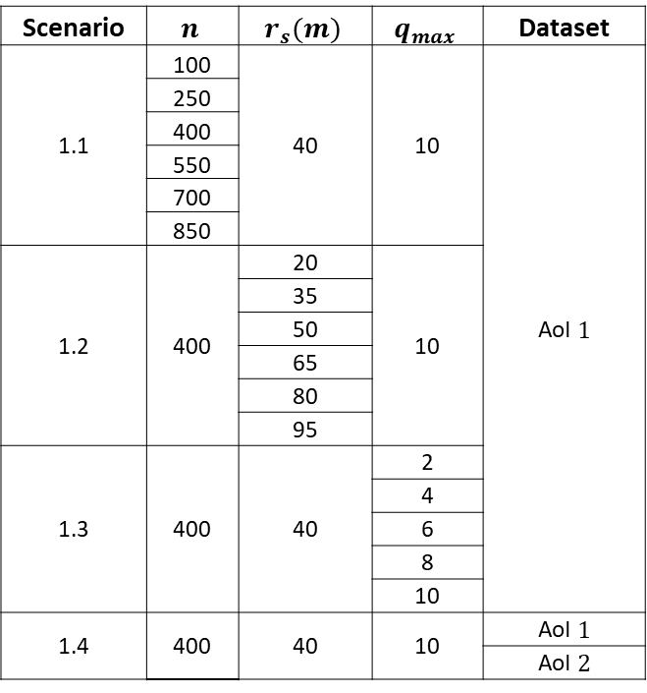
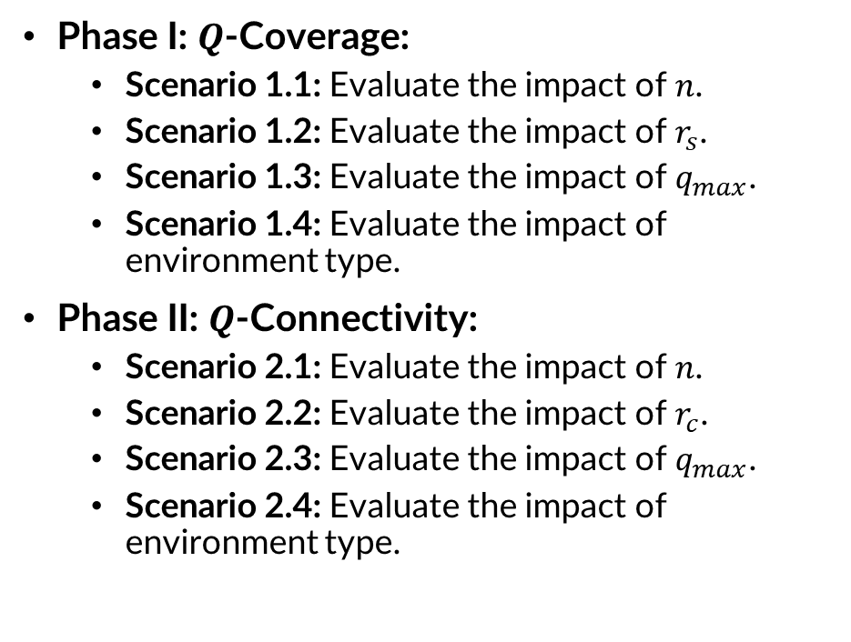
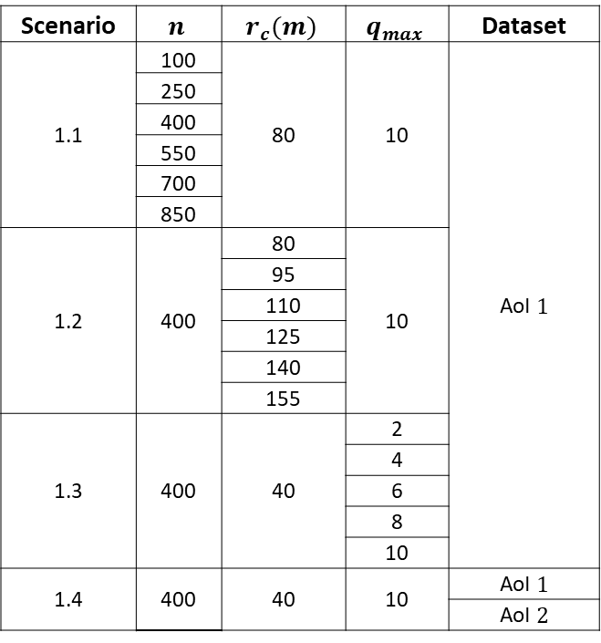
5.3. Experiment scenario
Phase I: $Q$-Coverage:
Scenario 1.1: Evaluate the impact of $n$.
Scenario 1.2: Evaluate the impact of $r_{s}$.
Scenario 1.3: Evaluate the impact of $q_{max}$.
Scenario 1.4: Evaluate the impact of environment type.
Phase II: $Q$-Connectivity:
Scenario 2.1: Evaluate the impact of $n$.
Scenario 2.2: Evaluate the impact of $r_{c}$.
Scenario 2.3: Evaluate the impact of $q_{max}$.
Scenario 2.4: Evaluate the impact of environment type.
Scenario | $$n$$ | $$r_{s}(m)$$ | $$q_{max}$$ | Dataset
1.1 | 100 | 40 | 10 | AoI $1$
 | 250
 | 400
 | 550
 | 700
 | 850
1.2 | 400 | 20 | 10
 |  | 35
 |  | 50
 |  | 65
 |  | 80
 |  | 95
1.3 | 400 | 40 | 2
 |  |  | 4
 |  |  | 6
 |  |  | 8
 |  |  | 10
1.4 | 400 | 40 | 10 | AoI $1$
 |  |  |  | AoI $2$
Scenario | $$n$$ | $$r_{c}(m)$$ | $$q_{max}$$ | Dataset
1.1 | 100 | 80 | 10 | AoI $1$
 | 250
 | 400
 | 550
 | 700
 | 850
1.2 | 400 | 80 | 10
 |  | 95
 |  | 110
 |  | 125
 |  | 140
 |  | 155
1.3 | 400 | 40 | 2
 |  |  | 4
 |  |  | 6
 |  |  | 8
 |  |  | 10
1.4 | 400 | 40 | 10 | AoI $1$
 |  |  |  | AoI $2$

Slide 28

5.3. Experiment scenario
Baseline:
Phase I: $Q$-Coverage:
GLA: Choose potential region to place sensor greedily and then use Mixed Interger Programming to find the number of sensors
GN-DSD: Use coloring algorithm to find clique partitioning and place sensor one by one. Then check and remove redundant sensors.
Pha 2: $Q$-Connectivity:
CMFA: Use cluster algorithm then max flow theory to sequentially check the constraint satisfactory and add connections.
FCSA (Fully Connected Sensor Approach): Connect all$q_{i}$ sensors covering $t_{i}$ to base station $B$.

Slide 29


5.4. Experiment results: $Q$-Coverage
Impact of $n$:
When $n=850$, SPARTA-CP is $1.04$ times better than GLA and $1.39$ times better than GN-DSD.
SPARTA-CC can reduce the running time of vanilla SPARTA by $4256$ times when $n = 400$.

Slide 30


5.4. Experiment results: $Q$-Coverage
Impact of $r_{s}$:
When $r_{s}=65(m),$SPARTA-CC is $1.06$times better than GLA and $1.44$times better than GN-DSD. SPARTA-CP exhibits the fastest runtime when $r_{s}$ is large (i.e., more overlapping). When $r_{s}=95\left(m\right)$, it is $2305$times faster than GLA and $2.29$times faster than GN-DSD.

Slide 31


5.4. Experiment results: $Q$-Coverage
Impact of $q_{max}$:
When $q_{max}=10,$SPARTA-CC is $1.3$ times better than GN-DSD. SPARTA-CC exhibits the fastest runtime in all cases. It is $4392$ times faster than vanilla SPARTA, $4367$times faster than GLA and $5.78$times faster than GN-DSD when $q_{max}=10$.

Slide 32

5.4. Experiment results: $Q$-Coverage
Impact of environment type:
The high height variation in AoI $1$ poses challenges for achieving target sphere overlap $⇒$ more sensors. Moreover, the cluster size of SPARTA-CC and CP decreases, less intersections $⇒$ runtime decreases.

Slide 33

5.4. Experiment results: $Q$-Connectivity
Impact of $n$:
When $n=850$, GEMSTONE achieves a result that is $2.02$ times superior to CMFA and $21.81$ times better than the FCSA algorithm GEMSTONE significantly outperforms CMFA, being $129.31$ times faster.

Slide 34


5.4. Experiment results: $Q$-Connectivity
Impact of $r_{c}$:
When $r_{c}=155 (m)$, GEMSTONE exhibits a superiority of $3.17$ times over CMFA and $48.68$times over FCSA. GEMSTONE proves to be approximately $80$ times faster than CMFA and achieves a comparable speed to that of FCSA in this scenario.

Slide 35

5.4. Experiment results: $Q$-Connectivity
Impact of $q_{max}$:
When $q_{max}=10,$GEMSTONE exhibits a superiority of $1.55$times over CMFA and $17.10$times over FCSA. GEMSTONE is approximately $79$ times faster than CMFA while still achieving a comparable speed to FCSA.

Slide 36

5.4. Experiment results: $Q$-Connectivity
Impact of environment type:
The high height variation in AoI $1$ makes the distance between targets large $⇒$ more sensors, less overlap. $⇒$ more vertexes in each subset $V_{i}$ $⇒$ runtime increases.

Slide 37
Table of contents
1. Introduction
2. Related work
3. Problem formulation
4. Proposed method
5. Experimental result
6. Conclusion

Slide 38

6. Conclusion
Contributions:
Propose the formulation for $Q$-Coverage and $Q$-Connectivity in 3D WSNs.
Propose a two-phase approach with superior performance compared to other baselines.
Provide a realistic 3D dataset for the problem.
Future works:
Find more optimized algorithms for the problem.
Consider mobile network, energy constraints, and obtacles in the environment.
Published paper:
N. T. Hanh, H. T. T. Binh, V. Q. Truong, N. P. Tan and H. C. Phap, “Node placement optimization under Q-coverage and Q-connectivity constraints in wireless sensor networks,” Journal of Network and Computer Applications - ISI Q1, p. 103 578, 2023.
Completed paper:
Vu Quang Truong, Trinh The Minh, Do Minh Tam, Nguyen Thi Hanh, Huynh Thi Thanh Binh, Nguyen Xuan Thang, ”SPARTA-GEMSTONE: A two-phase approach for efficient node placement in 3D wireless sensor networks under Q-Coverage and Q-Connectivity constraints”.

Slide 39
THANK YOU!

